Slide 1
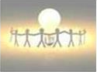

Introduction to Bootstrap
Topics
What and Why Bootstrap?
Advantages of Bootstrap
Getting started with Bootstrap
Bootstrap grid basics
Helper classes and responsive Utilities
Working with buttons
Q&A
Session Coming on:
Topic : Introduction to Bootstrap
Date : 24th Oct, 2018
Timing : 2:30 PM to 3:30 PM IST
Presenter : Camy Dsilva
Account : GE Corporate
Visit Us @: Capgemini GE GDC Intranet
Feedback @: GEInnovation@capgemini.com
Notes:
Fixar a posicao do titulo – sempre do lado esquerdo.
Sempre que tiver muito texto o coluna deve sempre ser “ narrowed” , se nao fica dificil de ler. Colocar paragrafos no texto.
Linha vertical deve ser mais fina e as pontas NUNCA devem ser arredondadas.

Slide 2
What and Why Bootstrap
What is Bootstrap :
Bootstrap is an open source, responsive design framework to build static websites and dynamic web applications..
Bootstrap was developed by Mark Otto and Jacob Thornton at Twitter. It was released as an open source product in August 2011 on GitHub.
Bootstrap is completely free to download and use.
Why Bootstrap :
Bootstrap's supports responsive design.
Bootstrap contains a dozen of built-in reusable components.

Slide 3
Bootstrap Advantages
Responsive design feature
Saves lot of development time
Consistency
Customizable
Support

Slide 4
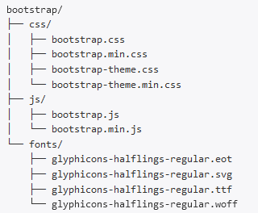
Getting started with Bootstrap
Bootstrap precompiled folder structure

Slide 5
Bootstrap grid basics
Bootstrap grid system is used for creating page layouts through a series of rows and columns . The grid system consist of 12 columns.
Devices | Bootstrap class
Extra small device-Mobile phones(<768px) | .col-xs-*
Small devices – Tablets(>=768px) Medium devices- Desktops (>=992px) | .col-sm-* .col-md-*
Large devices –Desktops(>=1200px) | .col-lg-*

Slide 6
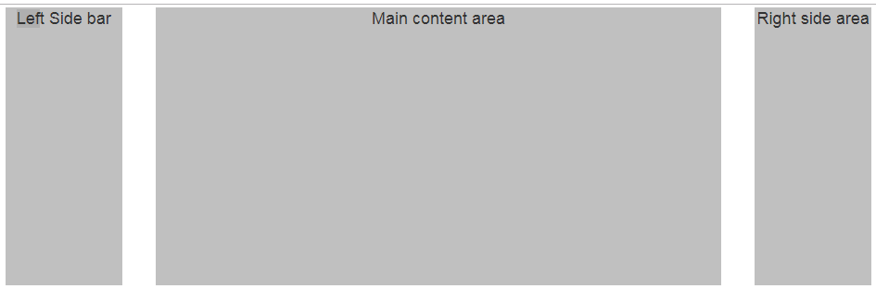
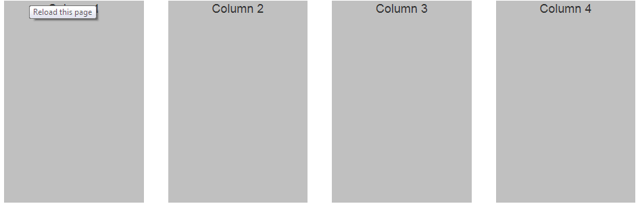
Bootstrap grid basics continued….
3 column layout:- ratio (1:4:1)
4 column layout :- ratio (1:1:1:1)

Slide 7
Bootstrap grid basics continued…
Grid classes for a given screen size apply to that screen size and large unless another declaration overrides it
Create 4 equal columns on medium device and large devices 3:1 ratio columns

Slide 8
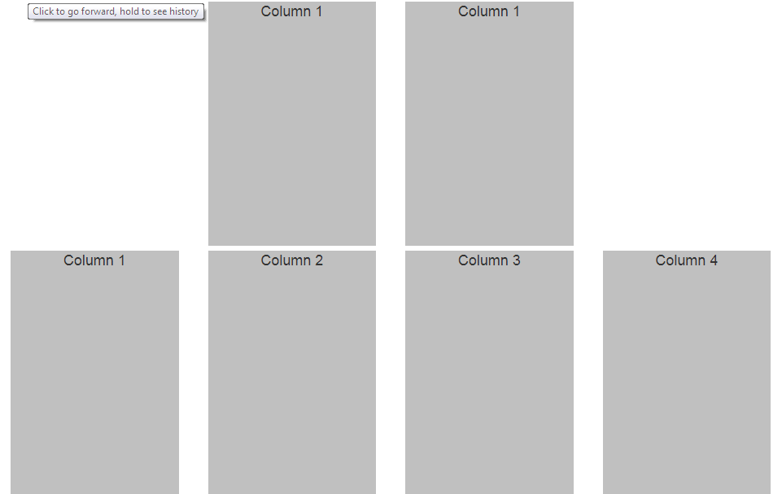
Bootstrap grid continued…
When creating websites using grid system you may want to move grid columns to the right for alignment purpose
Bootstrap grid classes | Bootstrap offset classes
.col-xs-* | .col-xs-offset-*
.col-sm-* .col-md-* | .col-sm-offset-* .col-md-offset-*
.col-lg-* | .col-lg-offset-*

Slide 9
Helper classes and responsive utilities
What are bootstrap responsive utility classes
They are useful for showing and hiding content by device via media query
The following are some of the responsive utility classes:-
class | purpose
Visible-xs | Visible on extra small devices
Visible-sm | Visible on small devices
Visible-md | Visible on medium devices
Visible-lg | Visible on large devices
Hidden-xs | Hidden on extra small devices
Hidden-sm | Hidden on small devices
Hidden-md | Hidden on medium devices
Hidden-lg | Hidden on large devices

Slide 10
Helper classes and responsive utilities continued..

Slide 11
Helper classes and responsive utilities continued..
Close Icon : It is used to dismiss models and alerts
<button type="button" class="close" aria-hidden="true">&times;</button>
Carets : : It is used to indicate dropdown functionality
<span class="caret"></span>
Quick floats : To float an element left or right with a class
<div class="pull-right">Right Aligned</div>
<div class="pull-left">Left Aligned</div>
Showing and hiding content
<div class="show">Show</div>
<div class="hidden">Hidden</div>
Notes:
Mobile first approach uses the grid system in particular is to layout designs first on small screens, such as those that come on a mobile phone and then it can be scaled up the size of those designs to larger and larger environments.
Prior to Bootstrap 3 It doesn't support mobile first approach and as a optional feature it supports Responsive web design.
Add instructor notes here.

Slide 12
Working with buttons
Bootstrap provides following options to apply styles to the button
<button class="btn btn-default">Default</button>
<button class="btn btn-primary">Primary</button>
<button class="btn btn-success">Success</button>
<button class="btn btn-info">Info</button>
<button class="btn btn-warning">Warning</button>
<button class="btn btn-danger">Danger</button>
<button class="btn btn-link">Link</button>
Notes:
Mobile first approach uses the grid system in particular is to layout designs first on small screens, such as those that come on a mobile phone and then it can be scaled up the size of those designs to larger and larger environments.
Prior to Bootstrap 3 It doesn't support mobile first approach and as a optional feature it supports Responsive web design.
Add instructor notes here.

Slide 13
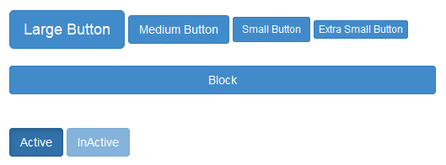
Working with buttons
Button has following sizes and states
<button class="btn btn-primary btn-lg">Large Button</button>
<button class="btn btn-primary btn-md">Medium Button</button>
<button class="btn btn-primary btn-sm">Small Button</button>
<button class="btn btn-primary btn-xs">Extra Small Button</button>
<button class="btn btn-primary btn-block">Block</button>
<button class="btn btn-primary btn-md active">Active</button>
<button class="btn btn-primary btn-md disabled">InActive</button>
Notes:
Mobile first approach uses the grid system in particular is to layout designs first on small screens, such as those that come on a mobile phone and then it can be scaled up the size of those designs to larger and larger environments.
Prior to Bootstrap 3 It doesn't support mobile first approach and as a optional feature it supports Responsive web design.
Add instructor notes here.

Slide 14
Any Questions?

Slide 15
Thank You!!

